Slide 1
Park 6 Salary Schedules
2025-2026

Slide 2
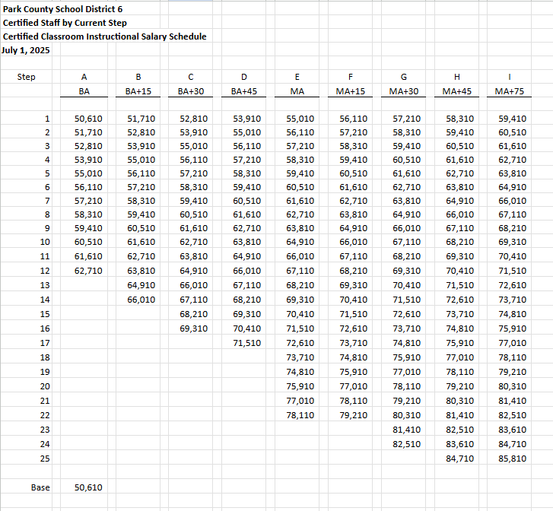
Notes:
Certified Staff by Current Step
$500 increase to the base (1% raise to the base)
$125 increase for each step

Slide 3
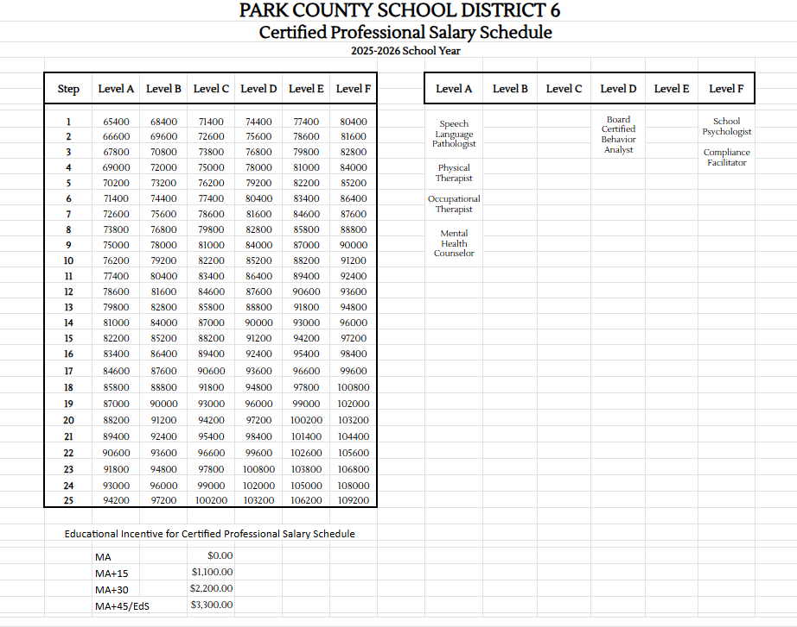
Notes:
Certified Professional Salary Schedule - 2% Raise to the Base

Slide 4
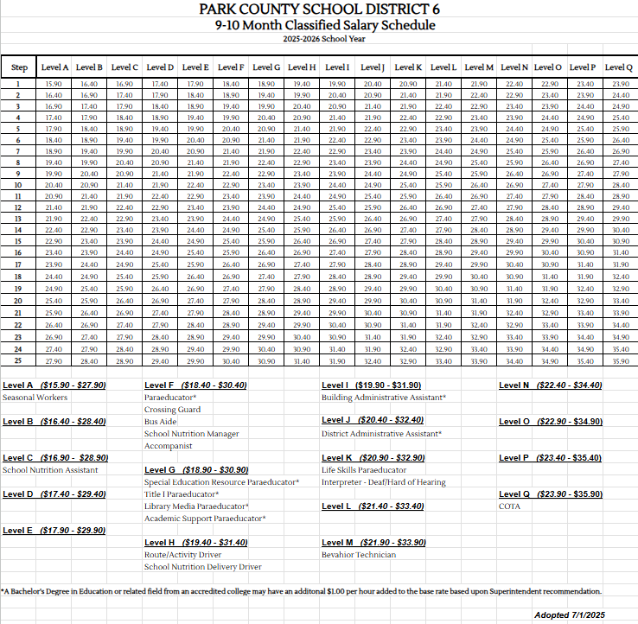
Notes:
9-10 Month Classified Salary Schedule - 2% raise to the base, added an additional 5 steps to allow for recruitment and retention of years of service. Added an educational incentive for administrative assistant positions.

Slide 5
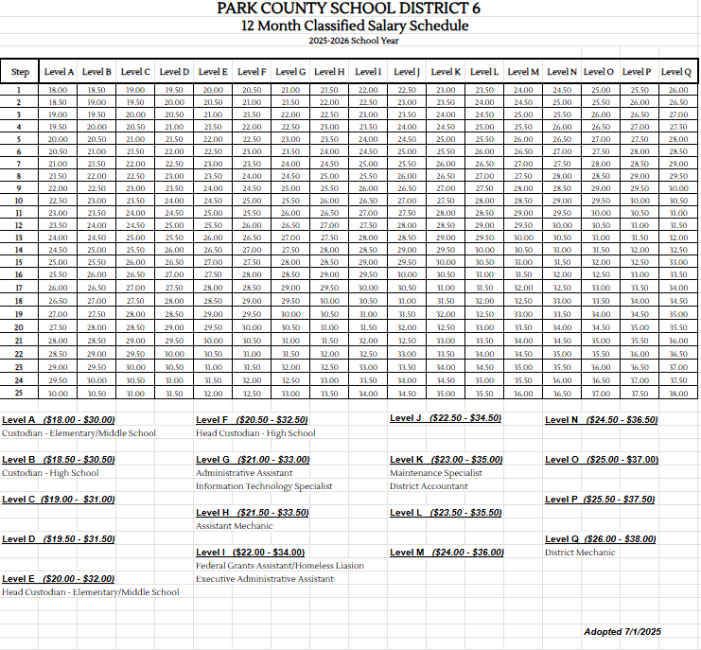
Notes:
12 Month Classified Salary Schedule - 2% raise to the base, added an additional 5 steps to allow for recruitment and retention of years of service.

Slide 6
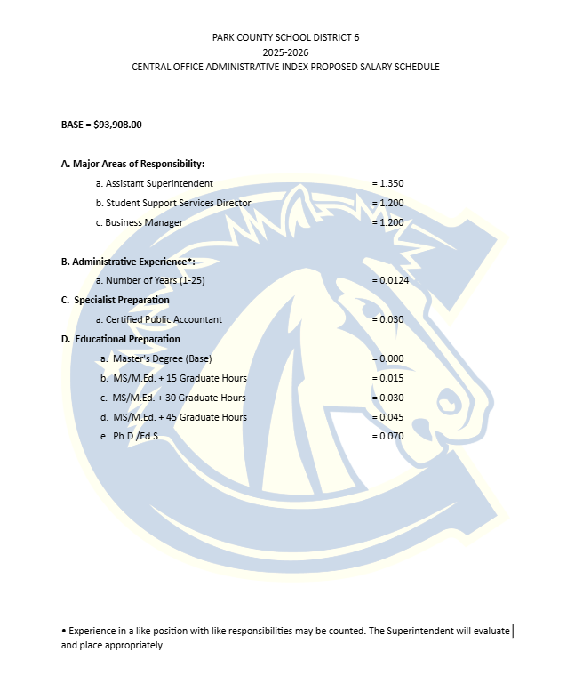
Notes:
CENTRAL OFFICE ADMINISTRATIVE SALARY SCHEDULE - 2% raise to the base

Slide 7
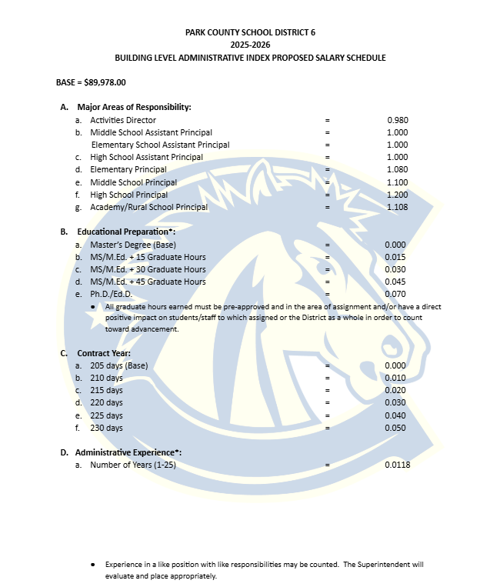
Notes:
BUILDING LEVEL ADMINISTRATIVE SALARY SCHEDULE - 2% raise to the base

Slide 8
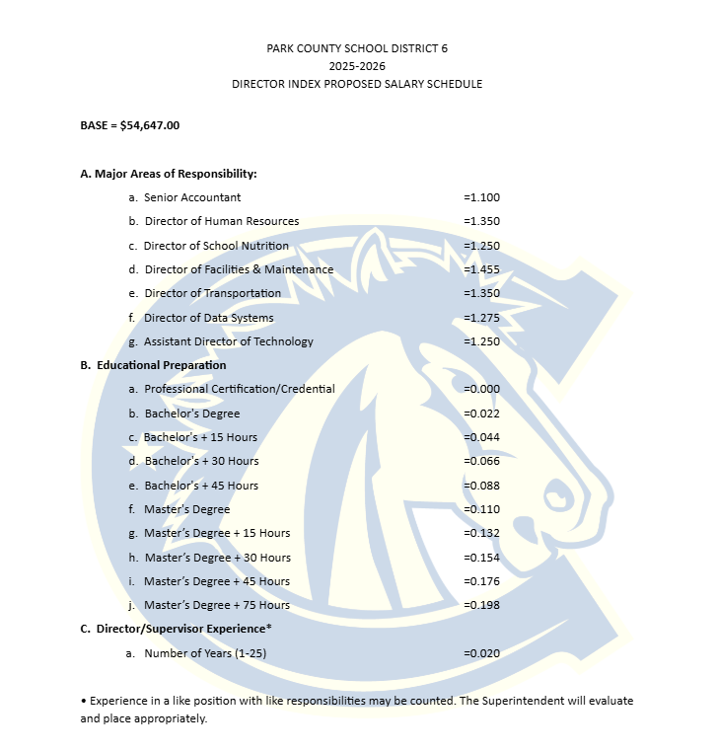
Notes:
Director Index Salary - 2% raise to the base

Slide 9
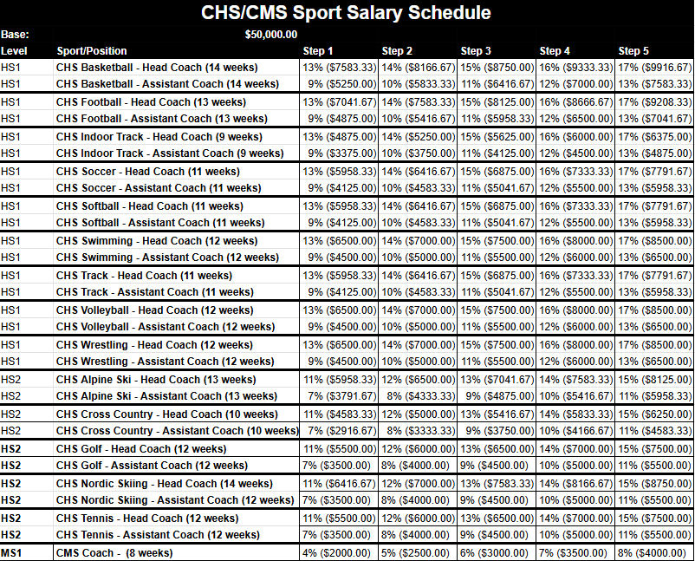
Notes:
CHS/CMS Sport Salary Schedule - No change

Slide 10
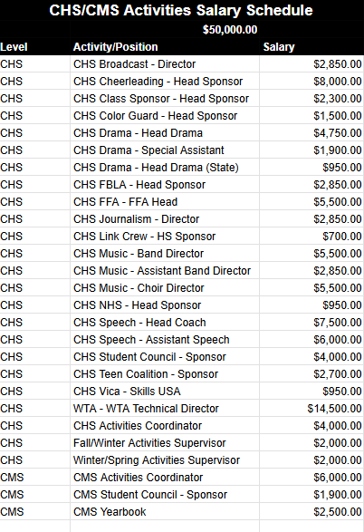
Notes:
CHS/CMS Activity Salary Schedule - Coordinators/Supervisors updated

Slide 11
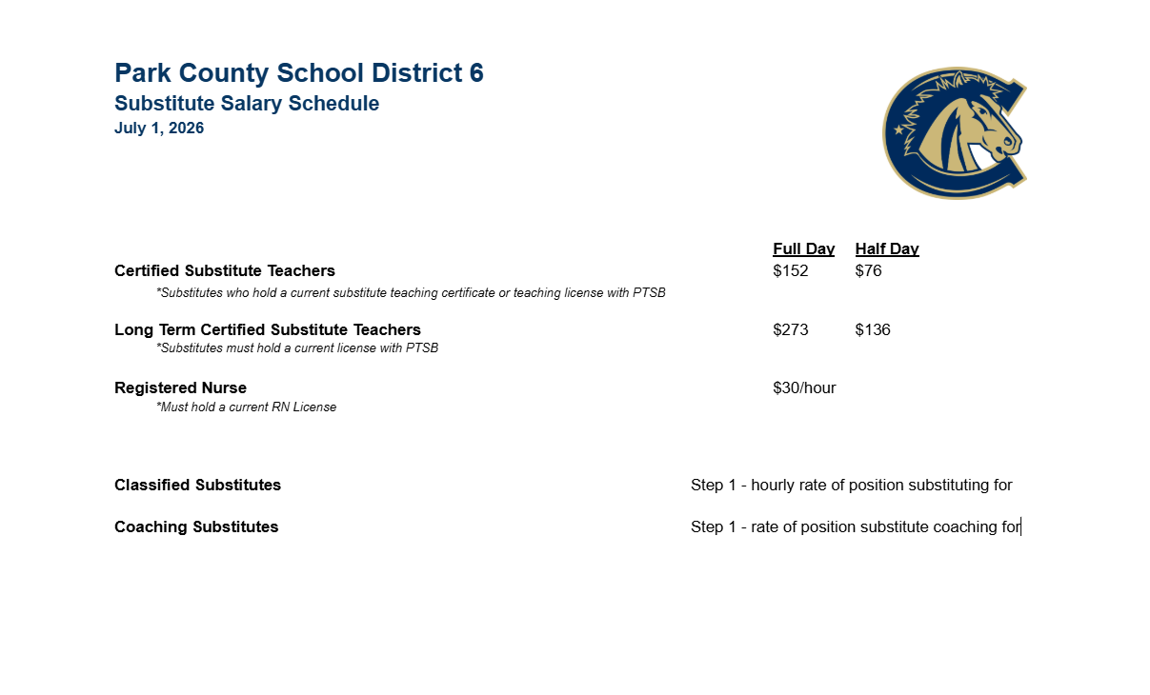
Notes:
Substitute Salary - updated to reflect Certifed Base Change

